Slide 1
Visual Analytics: Visual Queries
Ian Nabney
ian.nabney@bristol.ac.uk

Slide 2
Overview
Reading: Chapter 1 of Ware (e-book that can be downloaded from UoB library website)
Understand the basics of seeing, attention, and cognition
Able to relate these issues to design of information visualisation systems

Slide 3

Happy Chinese New Year!

Slide 4
Visual thinking
We have the impression that we see the world vividly, completely and in detail
This impression is completely wrong
At any given instant, we apprehend only a tiny amount of the information in our surroundings, but it is usually just the right information to carry us through the task of the moment
Keeping a copy of the world in our brains would be a huge waste of cognitive resources: it is much more efficient to see only what we attend to and only attend to what we need
Our illusory impression that we are constantly aware of everything happens because our brains arrange for eye movements to occur and relevant information picked up just as we turn our attention to something we need
This has led to a profoundly different model of perception

Slide 5
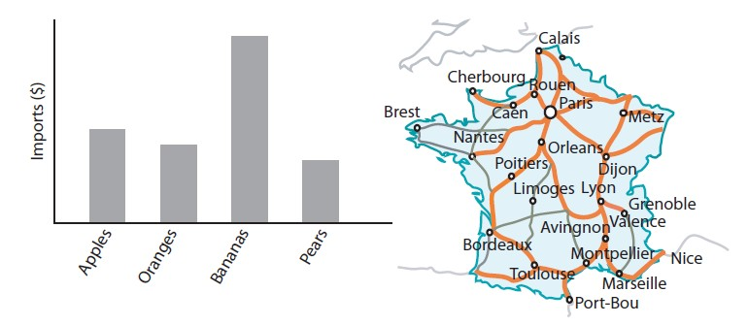
Graphic design: a new perspective
Visual thinking consists of a series of acts of attention, driving eye movements and tuning our pattern-finding circuits
These acts of attention are called visual queries, and understanding how they work can make us better designers
Which kind of fruit import is the largest by dollar value? What is the fastest route from Calais to Toulouse?
Write down how one answers these questions from the diagrams.

Slide 6
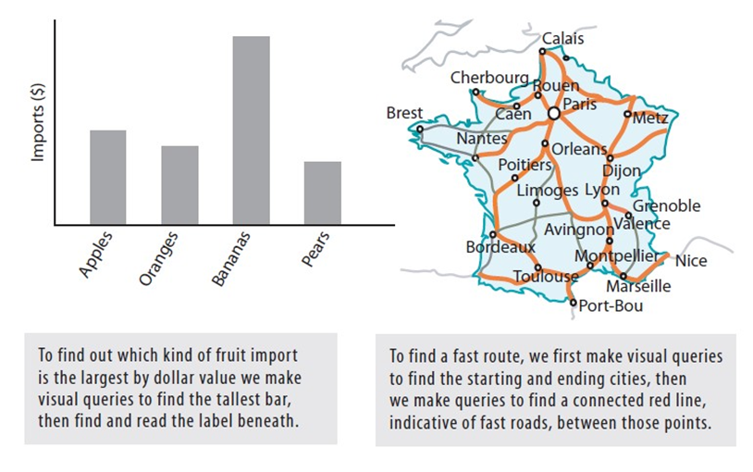
Solution

Slide 7
Apparatus and process of seeing
The eyes are like little digital cameras
Lenses focus an upside-down image on the eyeball
Pixels are an array of light-sensitive cones recording three different colours (leaving aside rods)
Brain pixels are concentrated in a central region called the fovea, whereas camera pixels are arranged in a uniform grid.
Brain pixels function as little image-processing computers, not just passive recorders
In the fovea, we can resolve c. 100 points on the head of a pin held at arm’s length, but the region is only about the size of our thumbnail held at arm’s length
At the edge of the visual field, vision is terrible; we can just resolve something the size of a human head
Notes:
The human eye actually contains four different receptor types, three cone types and rods. However, because rods function mainly only at low light levels, in our modern, brightly lit world we can for all practical purposes treat the eye as a three-receptor system. It is because of this that we need only three different wavelength receptors in digital cameras.

Slide 8
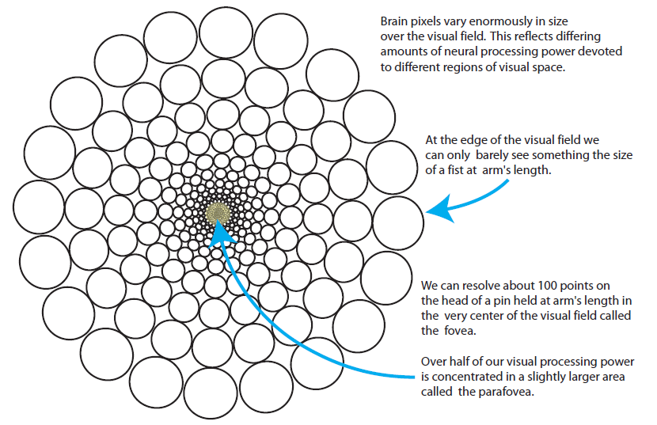
Brain pixels

Slide 9
Eye movements
Half our visual brain power is directed to processing less than 5 percent of the visual world This is why we have to move our eyes; it is the only way we can direct our brain power where it is most useful
Strong eye muscles attached to each eyeball rotate it rapidly so that different parts of the visual world become imaged on the central high-resolution fovea
The muscles accelerate the eyeball to an angular velocity up to 900 degrees per second, then stop it, all in less than one-tenth of a second
During a saccadic eye movement, vision is suppressed
Controlling these eye movements is a key part of the skill of seeing

Slide 10
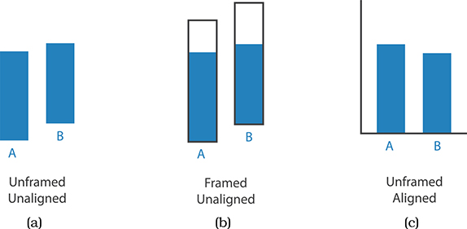
Recap: relative and absolute judgement
The human perceptual system is fundamentally based on relative judgements, not absolute ones; Weber’s Law
For instance, the amount of length difference we can detect is a percentage of the object’s length
This principle holds true for all sensory modalities: our senses work through relative rather than absolute judgements
How do you think this relates to what you have just learned about eye movements and the fovea?

Slide 11
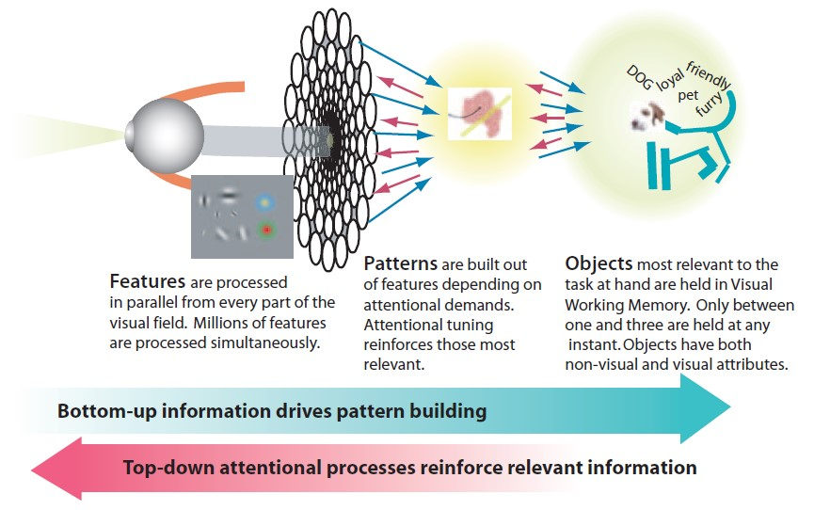
Act of perception

Slide 12
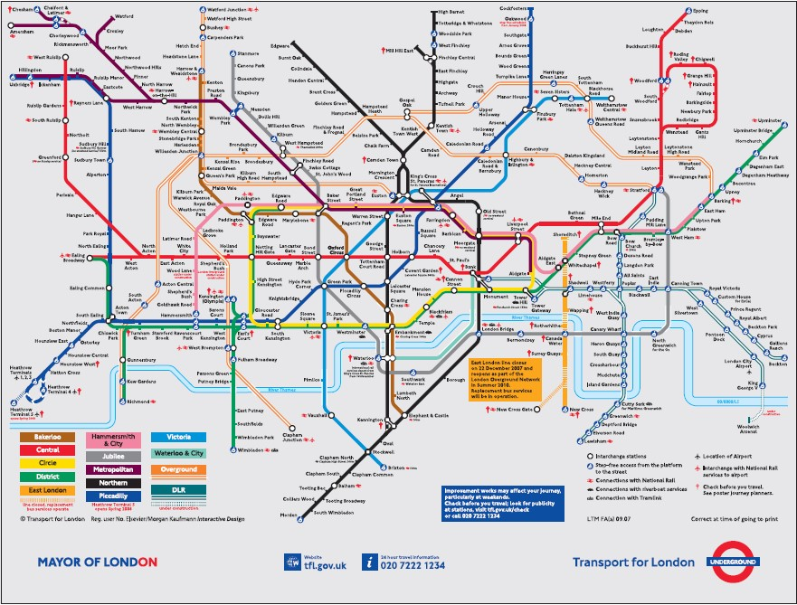
Implications for design
Original design by Harry Beck, 1933
Notes:
The goal of information design must be to design displays so that visual queries are processed both rapidly and correctly for every important cognitive task the
display is intended to support. This has a number of important ramifications for graphic design. The first is that in order to do successful design we must understand the cognitive tasks and visual queries a graphic is intended to support. This normally done somewhat intuitively, but it can also be made explicit.

Slide 13
Task analysis
Suppose we are in a hotel near Ealing in West London, and we wish to go to a pub near Clapham Common where we will meet a friend
Which combination of lines will get us to the pub?
If there is more than one potential route, which is the shortest?
What are the names of stations where train changes are needed?
How long will the trip take?
What is the distance between the hotel and its nearest underground station?
What is the distance between the pub and its nearest underground station?
How much will it cost?
Exercise: write down a cognitive plan for solving this problem (consider the first three elements) – I suggest 4 steps. Think through how you solve the problem yourself

Slide 14
A solution
STEP ONE is to construct a visual query to locate the station nearest our hotel. Assuming we have the name of a station, this may take quite a protracted visual search since there are more than two hundred stations on the map; if, as is likely, we already have a rough idea where in London our hotel is located, this will narrow the search space.
STEP TWO is to visually locate a station near the pub, and this particular task is also not well supported. The famous map does support the station-finding task by spacing the labels for clear reading, but unlike other maps it does not give an index or a spatial reference grid.
STEP THREE is to find the route connecting our start station and our destination station. This visual query is very well supported by the map. The lines are carefully laid out in a way that radically distorts geographical space, but this is done to maintain clarity so that the visual tracing of lines is easy. Colour coding also supports visual tracing, as well as providing labels that can be matched to the table of lines at the side.
STEP FOUR is a visual query to get a rough estimate of how many stations there are on the route. This is unlikely to involve actual counting; instead, it will be a judgment that will be used together with prior experience to produce an estimate of the journey duration. This will naturally lead to misjudgements because the lengths of lines on the map do not correspond to travel times.

Slide 15
Analysis
The London Underground map supports the visual route-finding step well but almost completely fails to support other planning steps such as finding a tube station near to the pub and estimating journey time
This is not to say that it is a bad design; the map is justifiably famous
The designers sacrificed spatial accuracy in favour of clear labels and routes, and therefore the map is very poor for providing information about the distance covered on the ground
Alternatives have been created
Walking map http://content.tfl.gov.uk/walking-tube-map.pdf
Geographic map https://www.whatdotheyknow.com/request/224813/response/560395/attach/3/London%20Connections%20Map.pdf

Slide 16
Conclusion
Perception is a skilled active process
Eye movements are executed to satisfy our need for information and can be thought of as a sequence of visual queries on the visual world
Each time the eye briefly comes to rest, the pattern-processing machinery sorts out what is most likely to be relevant to our current cognitive task
Almost everything else is either not seen at all or retained for only a fraction of a second
A few fragments are held for a second or two, and a tiny percentage forms part of our long-term memory
The special skill of designers is the talent to analyse a design in terms of its ability to support the visual queries of others

